Slide 1
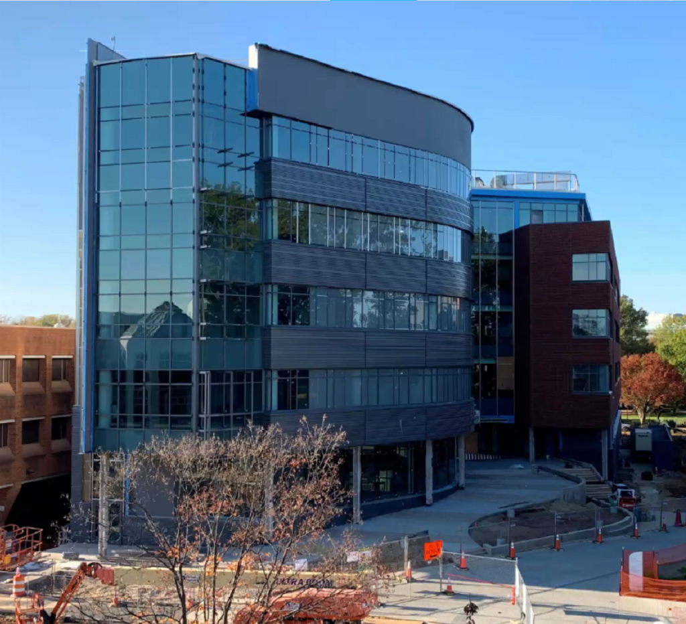
Horizon Hall Classroom Setup

Slide 2
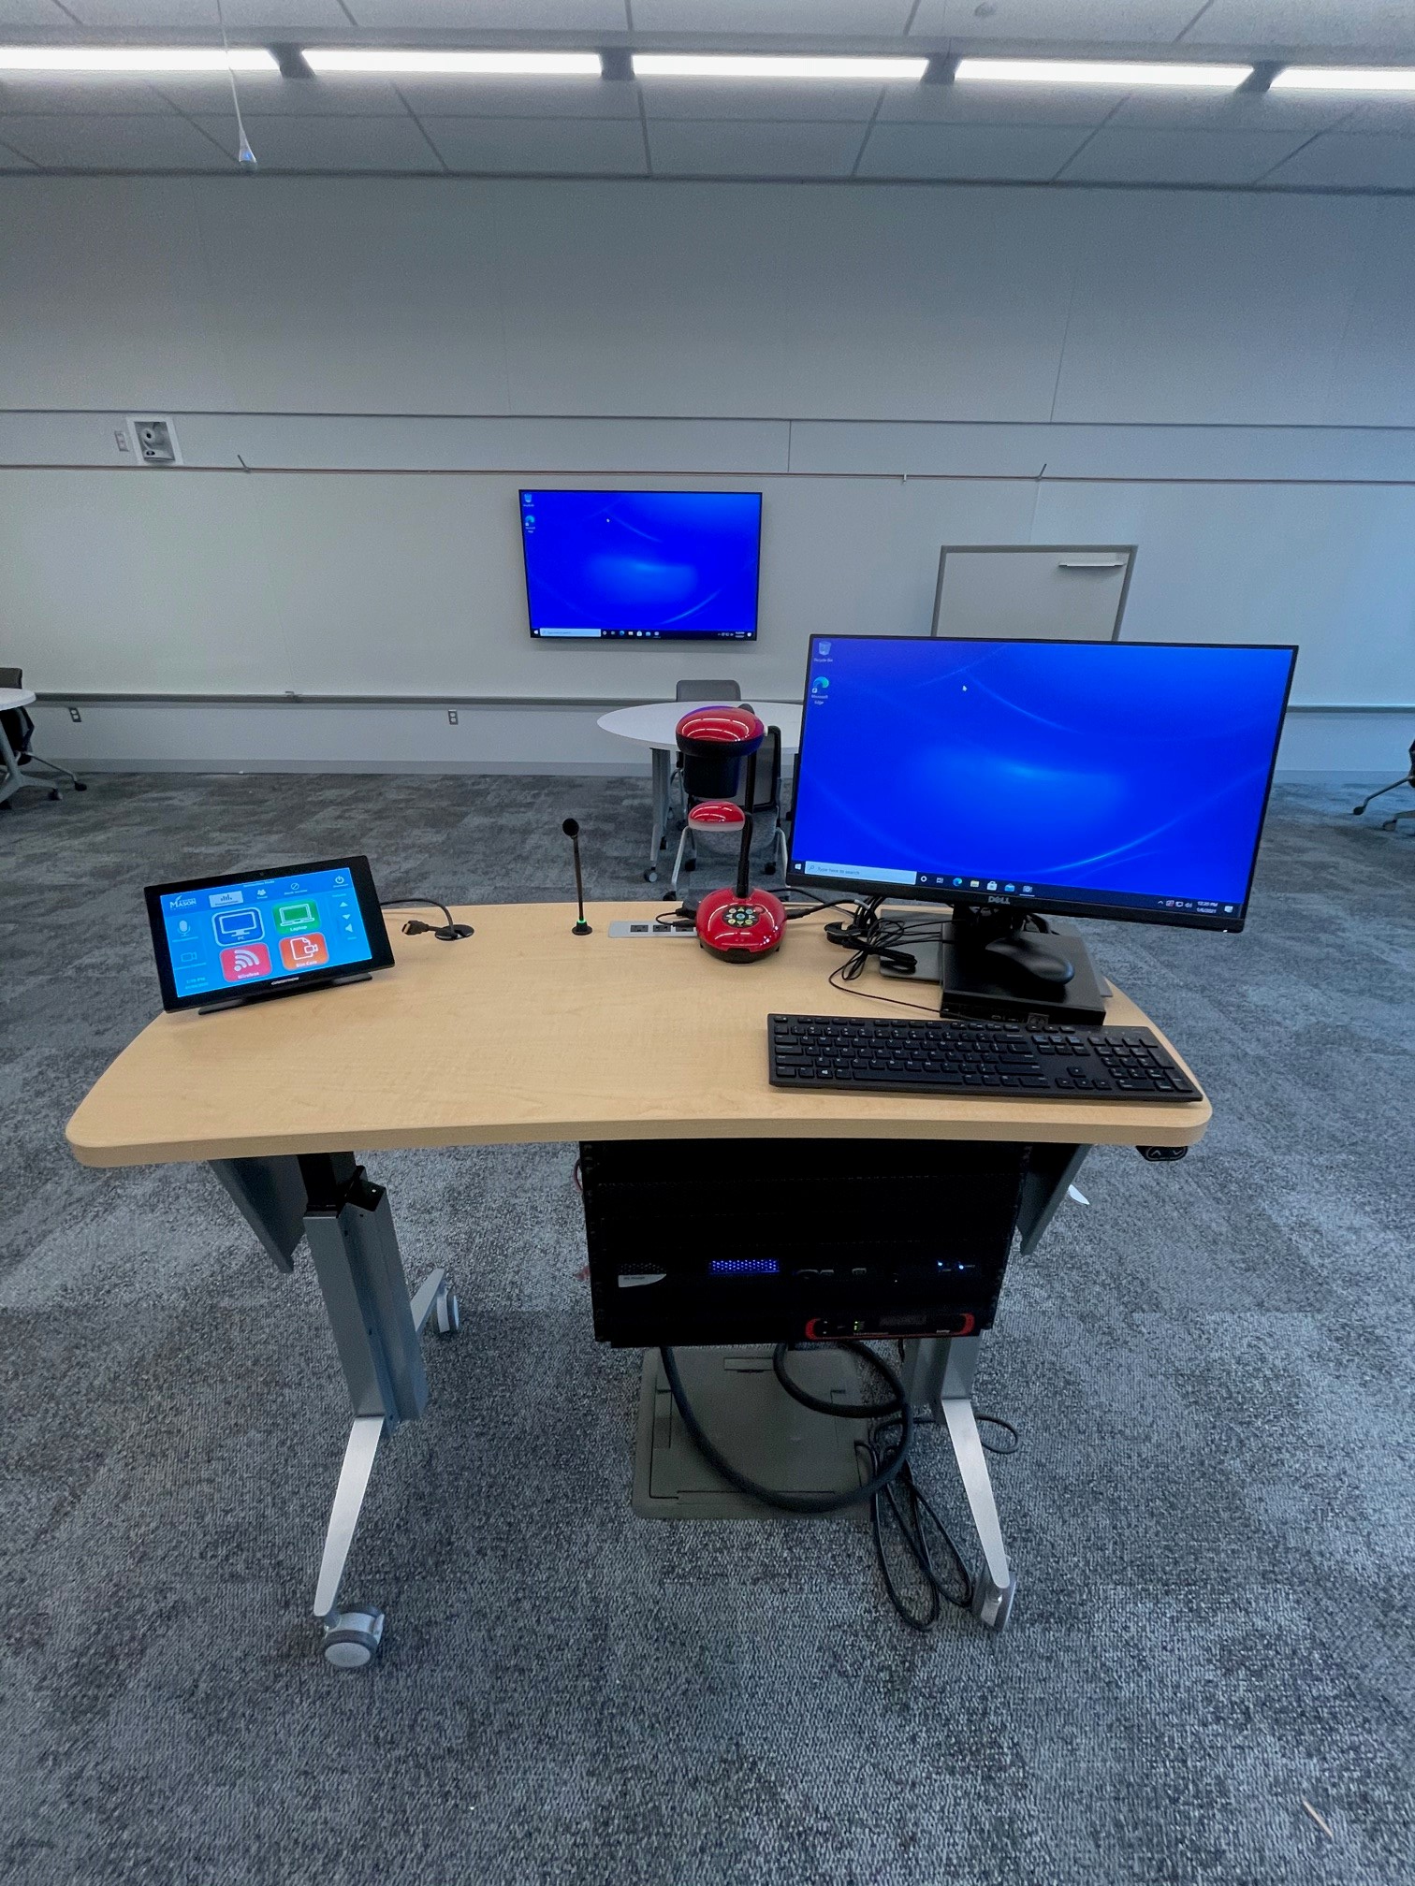
Lectern Front
Lectern Rear

Slide 3
Touch Panel Main Screen

Slide 4
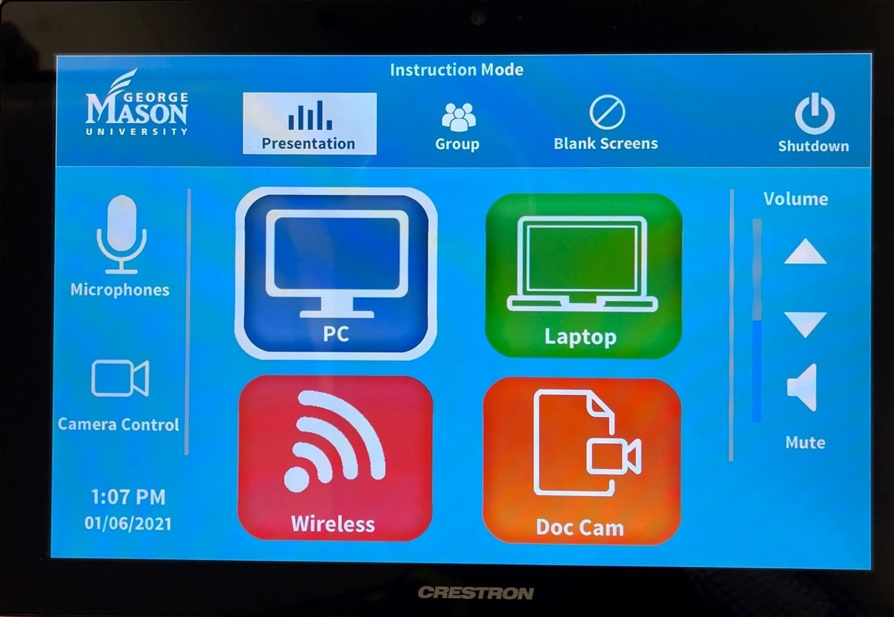
Touch Panel Presentation Mode Selections

Slide 5
Touch Panel Group Mode Selections
Group mode allows students to work on individual displays by connecting wirelessly. When faculty selects a group on the touch panel that group content will be shared to the rest of the room on the monitors.

Slide 6
Touch Panel End Class Selections

Slide 7
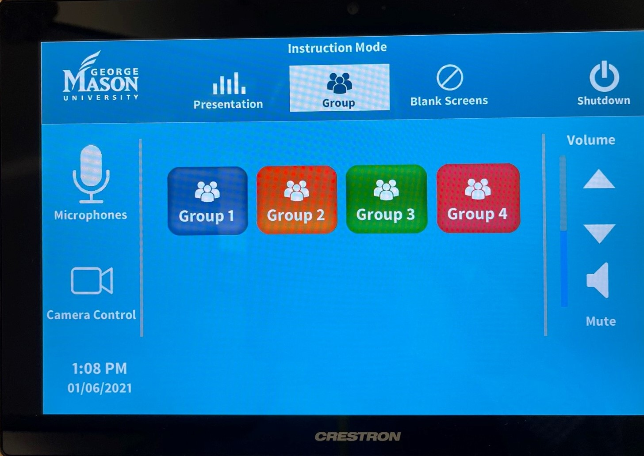
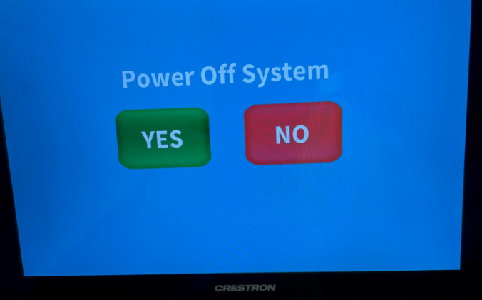
Touch Panel Presentation Mode Selections
Touch Panel Main Screen
Touch Panel Group Mode Selections
Touch Panel End Class

Slide 8
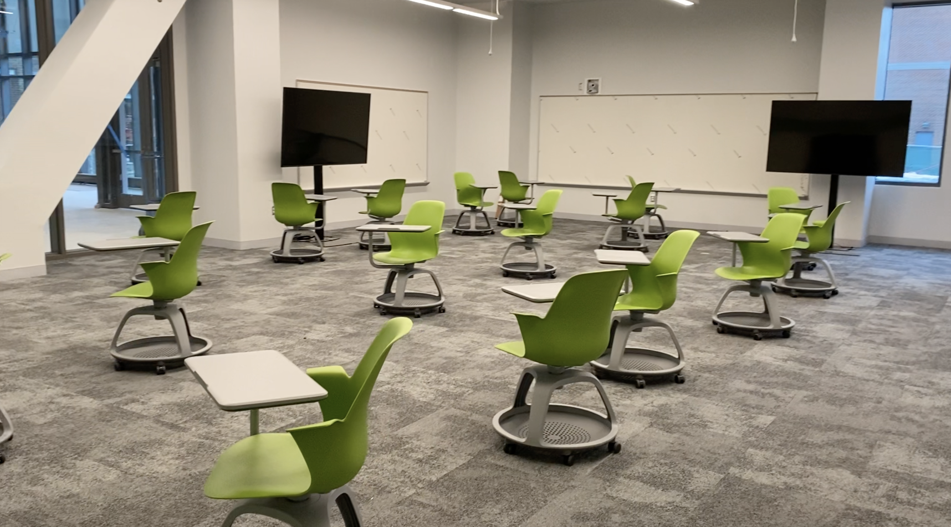
Room 1008
View from entrance door
View from just past entrance door wall

Slide 9
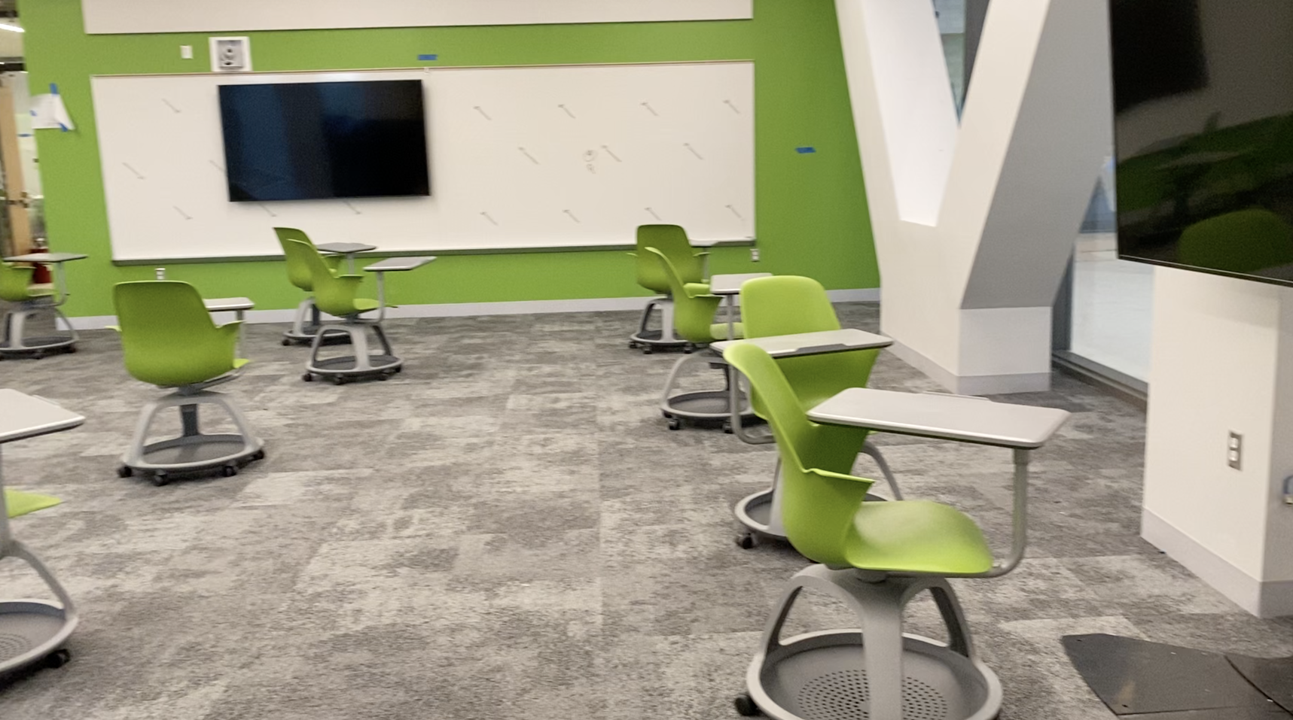
Room 1008
View from far corner of room to Lectern
View from far corner of room to entrance door on the left

Slide 10
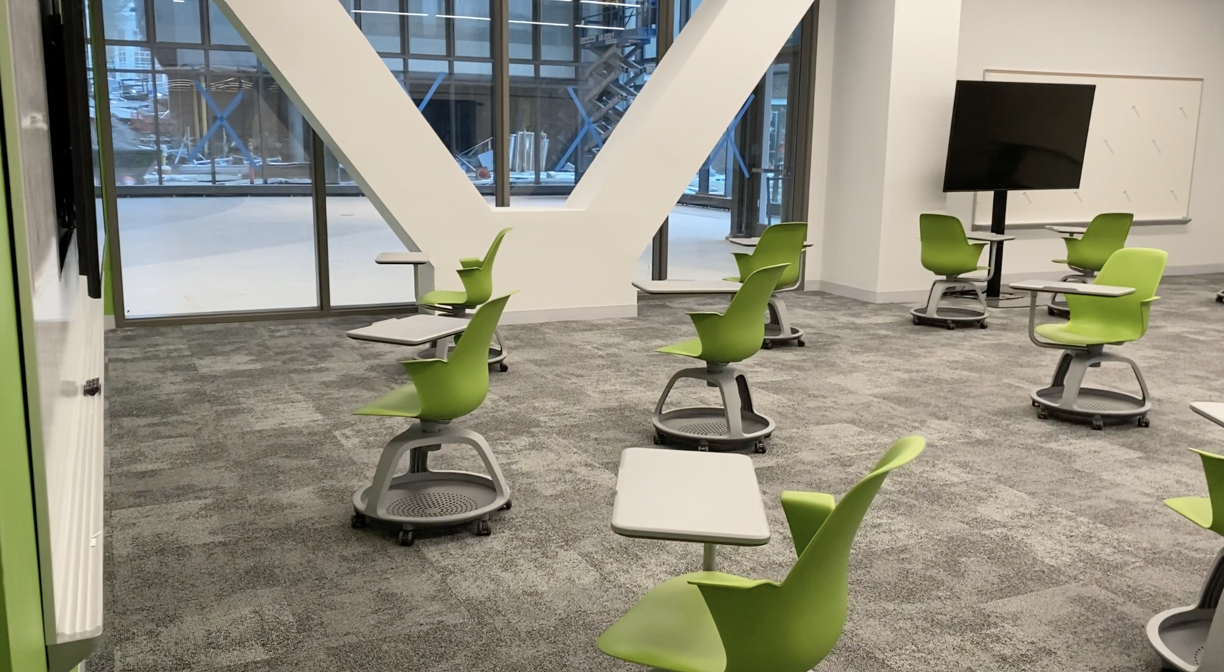
Room 1008
Display and whiteboard
View to hall outside by Word Wall

Slide 11
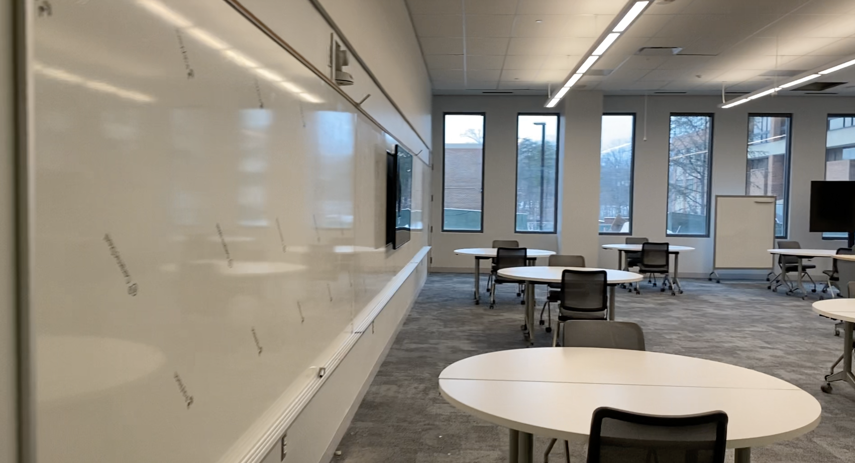
Room 1010
View from entrance door, left side or room
View from entrance door, right side of room

Slide 12
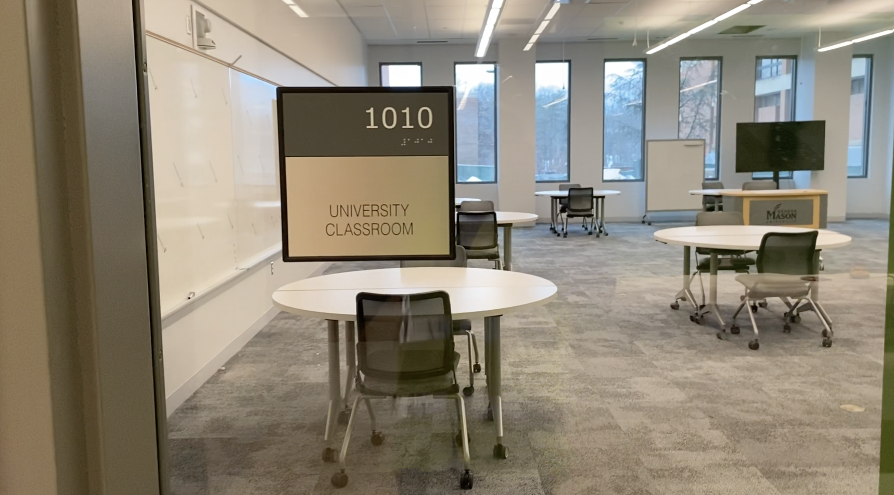
Room 1010
View from just outside the entrance door
View to far corner of room

Slide 13
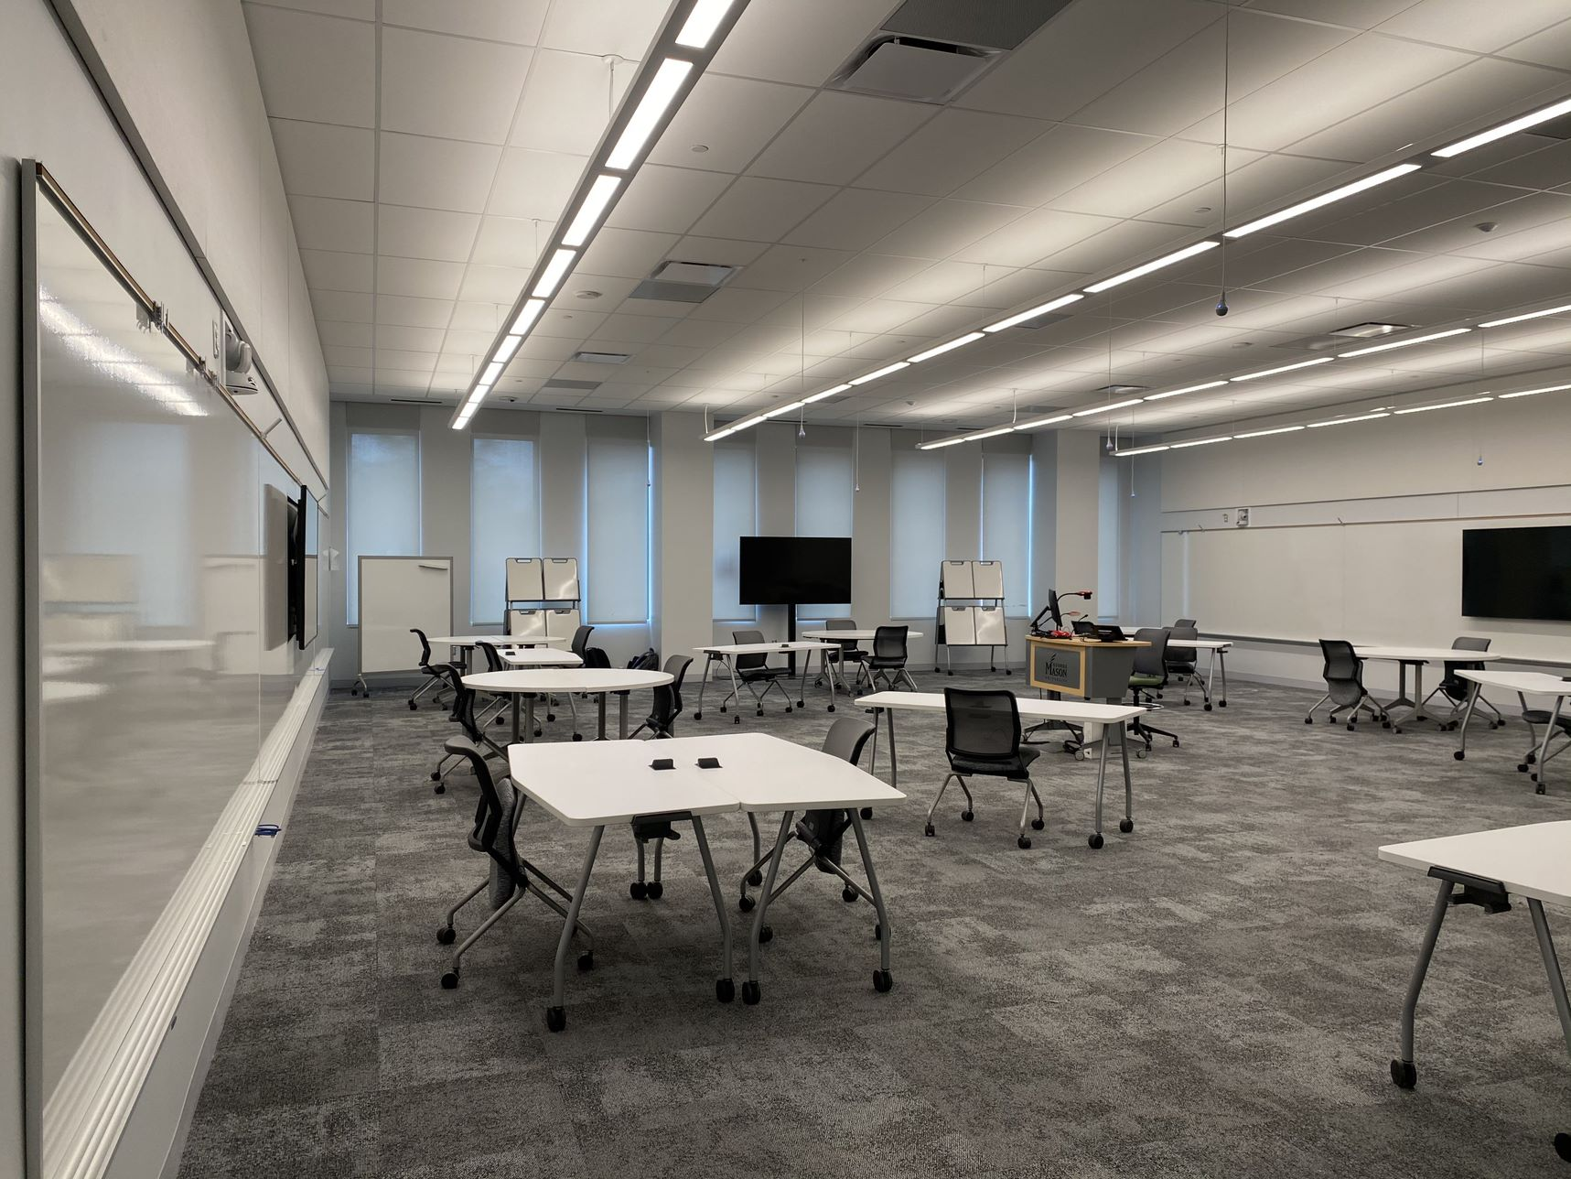
Room 1012
View from just inside the entrance door
View from wall to wall

Slide 14
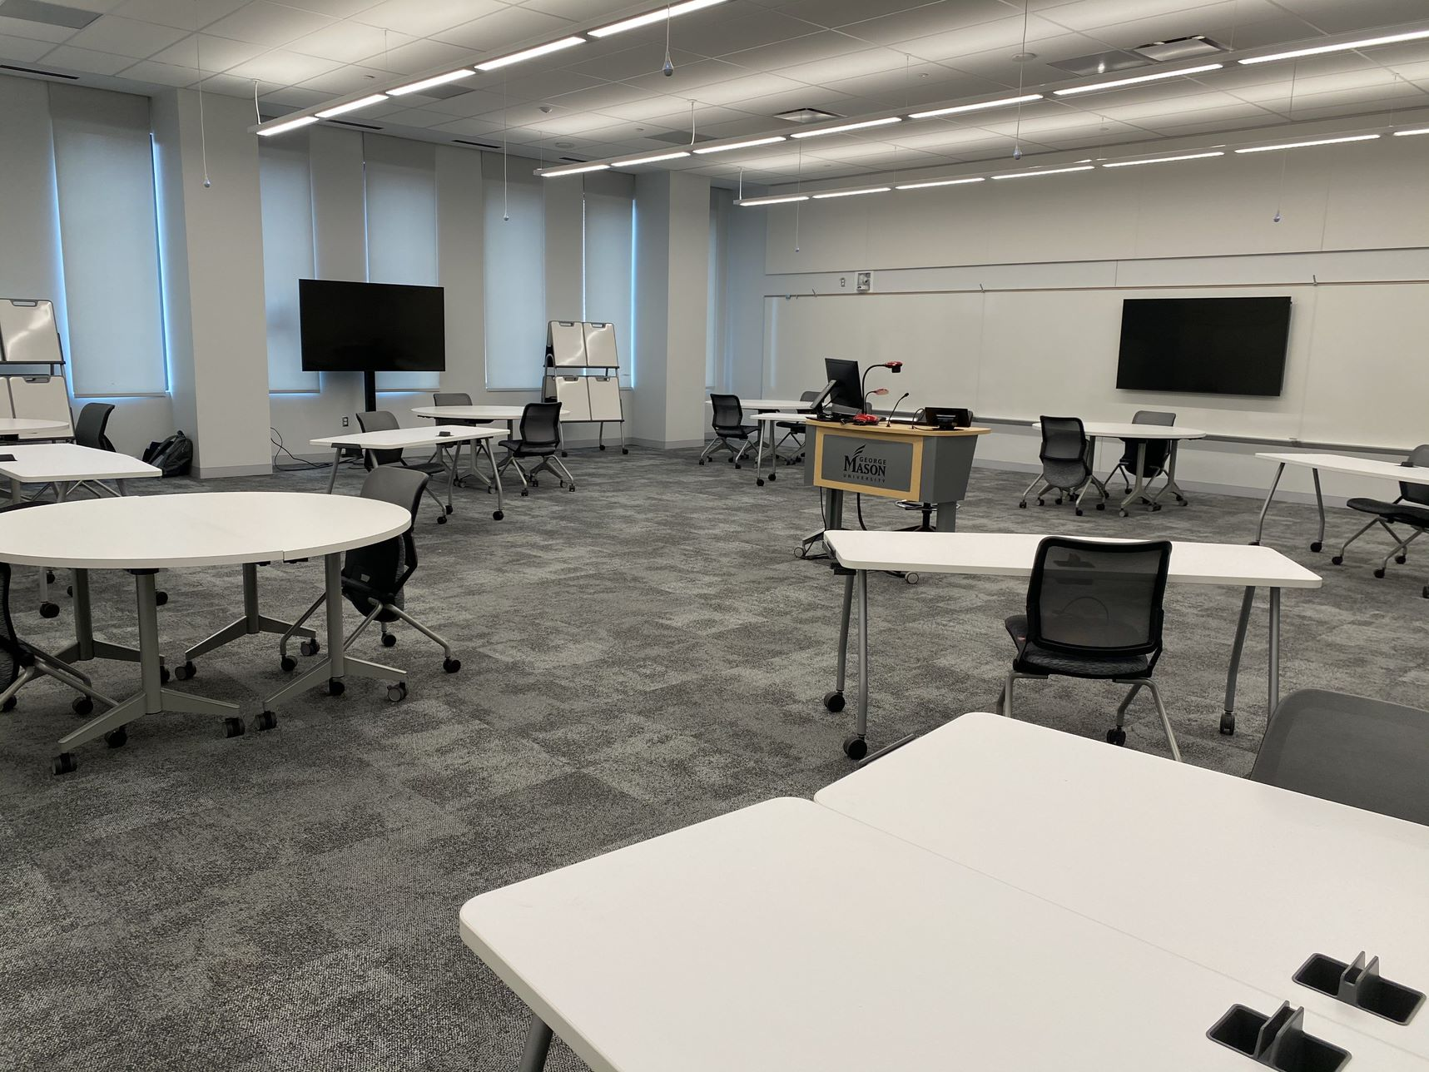
Room 1012
View from just inside the entrance door to far corner
Lectern pc displaying fire alarm message

Slide 15
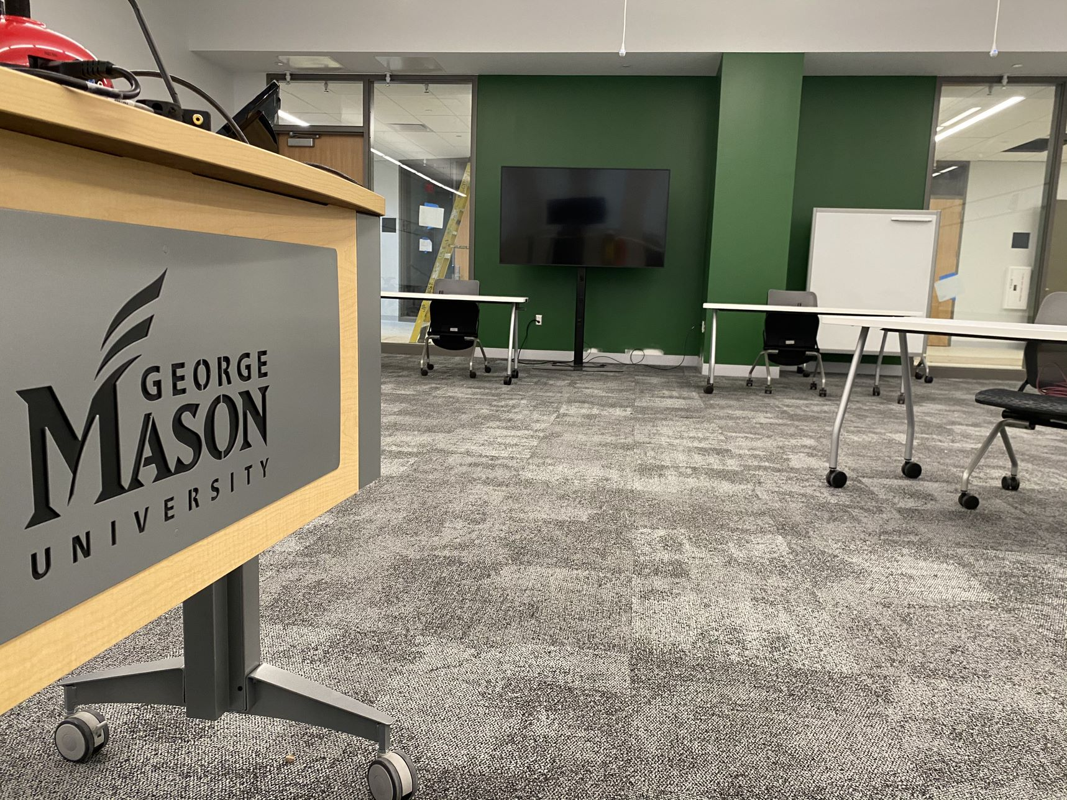
Room 1012
View from Lectern to entrance doors
View from just outside the entrance door

Slide 16
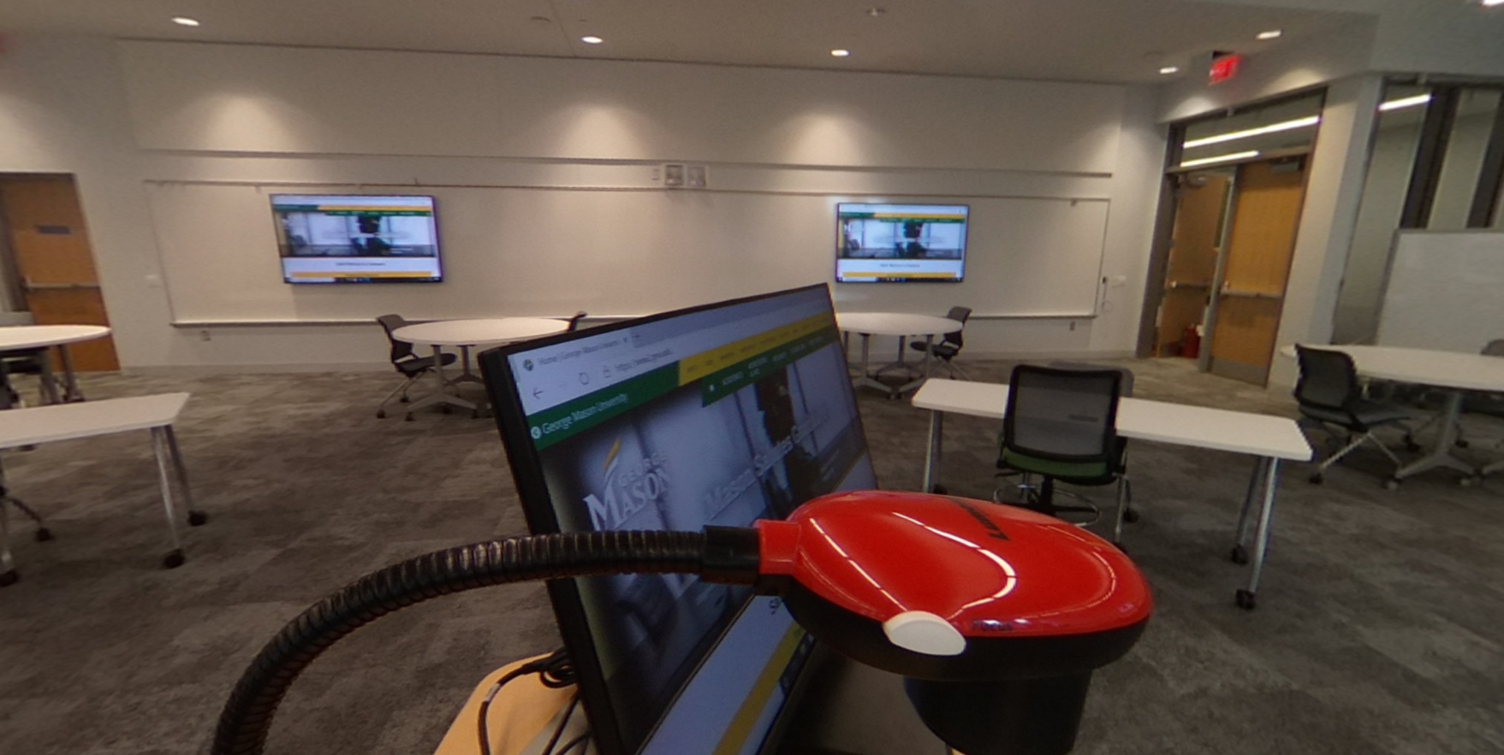
Room 1014
View from Lectern to entrance door
View from Lectern to far wall

Slide 17
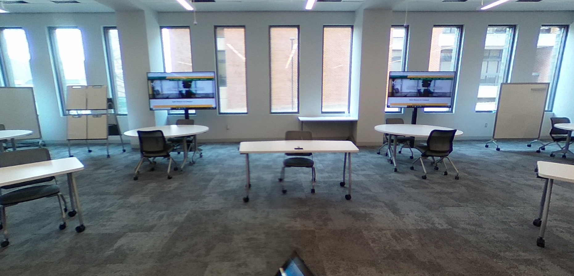
Room 1014
View from Lectern to window wall
View from Lectern to entrance door

